Slide 1


CE141: COMPUTER CONCEPTS & PROGRAMMING
July – November 2018
Chapter – 5
Constants, Variables & Data Types in ‘C’
Devang Patel Institute of Advance Technology and Research

Slide 2


Objectives
To be able to create and use variables and constants.
To be able to distinguish the constants of different data type.
To be able to name, declare, initialize and assign values to variables.
To become familiar with fundamental data types.
To be able to list, describe, and use the C basic data types.
Chapter – 5 : Constants, Variables & Data Types in ‘C’

Slide 3
Introduction
In this chapter, we will discuss
    Character set
    C Tokens
    Constants (integer, real, character, string, enum), symbolic constants
    Variables (name, declare, assign)
    Fundamental data type ( int, float, double, char, void)

Slide 4
Character Set
Every language contains a set of characters used to construct words, statements etc.
C language character set contains the following set of characters...
    Alphabets
    Digits
    Special Symbols
    White spaces
      Compiler ignores white spaces unless they are part of a string constant.
      White spaces may be used to separate words but prohibited between characters of keywords and identifiers.

Slide 5
Character Set
LETTERS: Uppercase A….Z, lower case a..z
DIGITS: All decimal digits 0..9
SPECIAL CHARACTERS: comma(,), period(.), semicolon(;), colon(:), question mark(?), quotation(“), dollar sign($), slash(/),back slash(\), percent sign(%), underscore(_), ampersand(&), asterisk(*), number sign(#).
WHITE SPACES: Blank space, Horizontal tab, Carriage return, Newline, Form feed.
Chapter – 2 : Algorithms and Flowcharts

Slide 6
Trigraph characters
C introduces the concept of trigraph sequences to provide a way to enter certain characters that are not available on some keywords.
Each Trigraph sequence consists of three characters, 2 question marks followed by another character.
Trigraph sequence | Equal character
??= | #
??( | [
??) | ]
??/ | \
??< | {
??> | }
??! | |
??’ | ^
??- | ~

Slide 7
C Tokens
Every C program is a collection of instructions and every instruction is a collection of some individual units.
Every smallest individual unit of a c program is called token.
Every instruction in a c program is a collection of tokens.
Tokens are used to construct c programs and they are said to the basic building blocks of a c program.

Slide 8
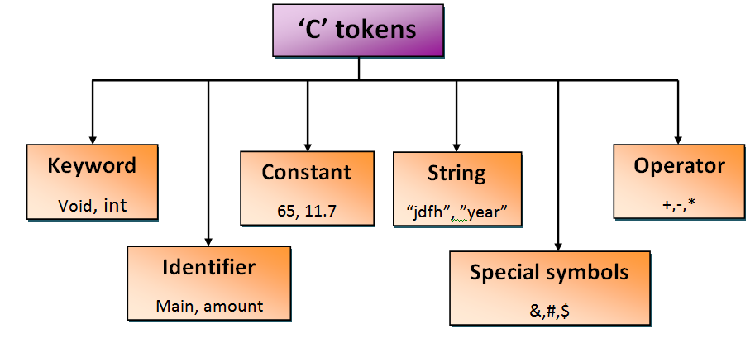
C Tokens

Slide 9
Keywords
Keywords are the reserved words with predefined meaning which already known to the compiler.
Properties of Keywords
  All the keywords are defined as lowercase letters so they must be use only in lowercase letters
  Every keyword has a specific meaning, users can not change that meaning.
  Keywords can not be used as user defined names like variable, functions, arrays, pointers etc...
  Every keyword represents something or specifies some kind of action to be performed by the compiler.

Slide 10
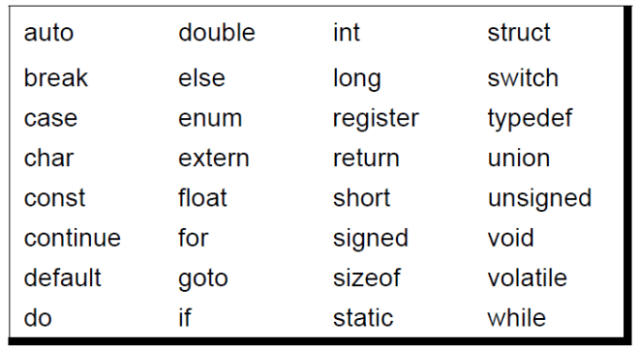
Keywords
Chapter – 2 : Algorithms and Flowcharts

Slide 11
Identifiers
Identifier is a user defined name of an entity to identify it uniquely during the program execution.
Example:
    int marks;
    char studentName[30];
Here, marks and studentName are identifiers.

Slide 12
Identifiers
Rules for creating Identifiers
  An identifier can contain letters (UPPERCASE and lowercase), numerics & underscore symbol only.
  An identifier should not start with numerical value. It can start with a letter or an underscore.
  We should not use any special symbols in between the identifier even whitespace. However, the only underscore symbol is allowed.
  Keywords should not be used as identifiers.
  There is no limit for length of an identifier. However, compiler consider first 31 characters only.
  An identifier must be unique in its scope.
Chapter – 2 : Algorithms and Flowcharts

Slide 13
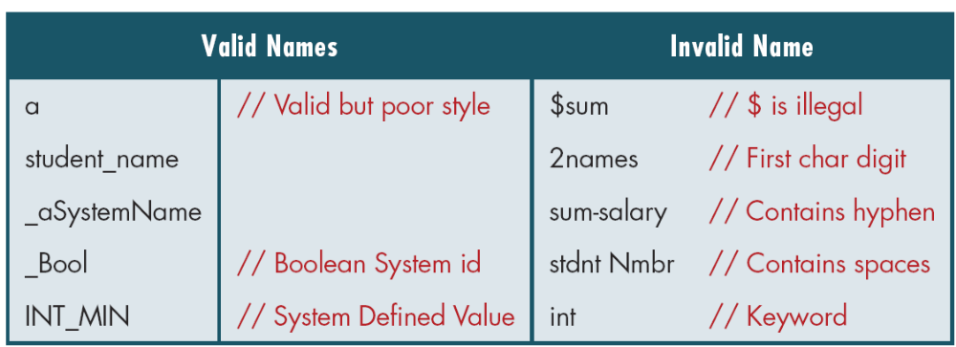
Examples of Valid and Invalid Names

Slide 14
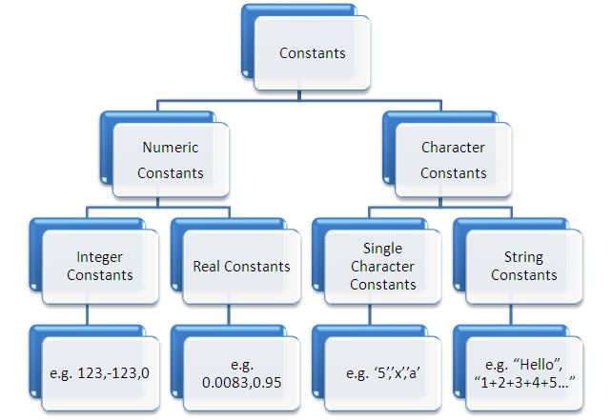
Constants
A constant is a named memory location which holds only one value throughout the program execution.

Slide 15
Creating constants in C
In c programming language, constants can be created using two concepts...
  Using 'const' keyword
  Using '#define' preprocessor

Slide 16
Creating constants in C
Using 'const' keyword
  To create a constant, we prefix the variable declaration with 'const' keyword.
  The general syntax for creating constant using 'const' keyword is as follows...
      const datatype constantName ;
      OR
      const datatype constantName = value ;
  Example
  const int x = 10 ;
    Here, 'x' is a integer constant with fixed value 10.

Slide 17
Creating constants in C
Using '#define' preprocessor
  To create constant using this preprocessor directive it must be defined at the beginning of the program (because all the preprocessor directives must be written before the gloabal declaration).
  We use the following syntax to create constant using '#define' preprocessor directive…
    #define CONSTANTNAME value
  Example:
    #define PI 3.14
    Here, PI is a constant with value 3.14

Slide 18
Constants in C- Example Program
//Using 'const' keyword
#include <stdio.h>
void main()
{
int i = 9 ;
const int x = 10 ;
i = 15 ;
x = 100 ; // creates an error
printf("i = %d\n x = %d", i, x ) ;
}
The above program gives an error because we are trying to change the constant variable value (x = 100).
//Using '#define' preprocessor
#include <stdio.h>
#defien PI 3.14
void main()
{
int r, area ;
printf("Please enter the radius of circle : ") ;
scanf("%d", &r) ;
area = PI * (r * r) ;
printf("Area of the circle = %d", area) ;
}

Slide 19
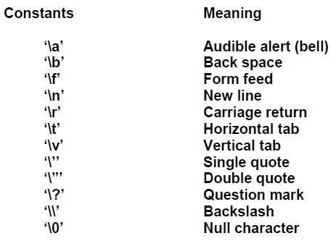
Backslash character constants
C supports special backslash character constants that are used in output functions.
These character combinations are known as escape sequences.

Slide 20
Variables
Variable is a name given to a memory location where we can store different values of same datatype during the program execution.
It must be declared in the declaration section before it is used.
It must have a datatype that determines the range and type of values to be stored.
A variable name may contain letters, digits and underscore symbol.

Slide 21
Variables
The following are the rules to specify a variable name...
  Variable name should not start with digit.
  Keywords should not be used as variable names.
  Variable name should not contain any special symbols except underscore(_).
  Variable name can be of any length but compiler considers only the first 31 characters of the variable name.
Valid variables are:
  john
  x1
  T_raise
  first_tag
Invalid variables are:
  123
  (area)
  25th
  price$
  %

Slide 22
Declaration of Variables
Declaration allocate required amount of memory with specified variable name and datatype values into that memory location.
The declaration can be performed either before the function as global variables or inside any block or function.
It must be at the beginning of block or function.
Syntax:
    Datatype variableName;
Example
    int number;
  The above declaration allocate 2 bytes(32 bit Compiler)/4 bytes(64 bit Compiler) of memory with the name number and allows only integer values into that memory location.
Chapter – 2 : Algorithms and Flowcharts

Slide 23
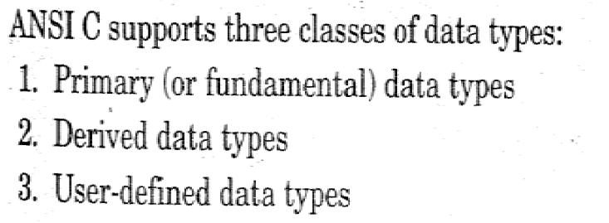
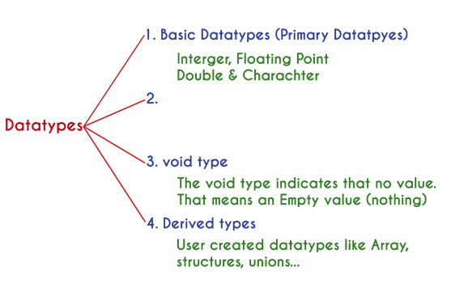
Datatypes
Datatype is a set of value with predefined characteristics.
Datatypes are used to declare variable, constants, arrays, pointers and functions.
The memory size and type of value of a variable are determined by varible datatype.
User-defined Data Types
The user defined data types enable a program to invent his own data types and define what values it can taken on

Slide 24
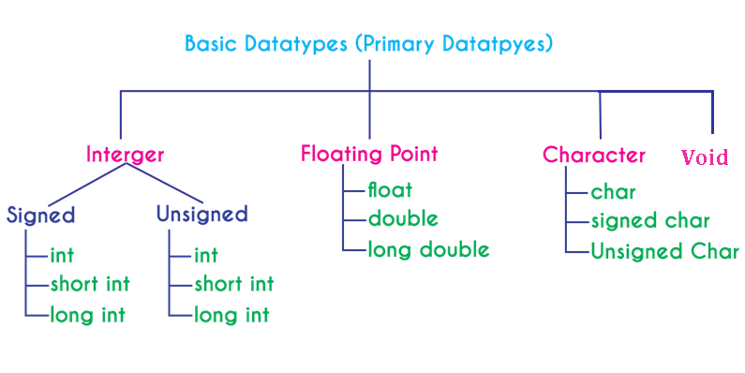
Datatypes- Primary Datatypes
All the primary datatypes are already defined in the system.
Primary datatypes are also called as Built-In datatypes.
The following are the primary datatypes in c programming lanuage...

Slide 25
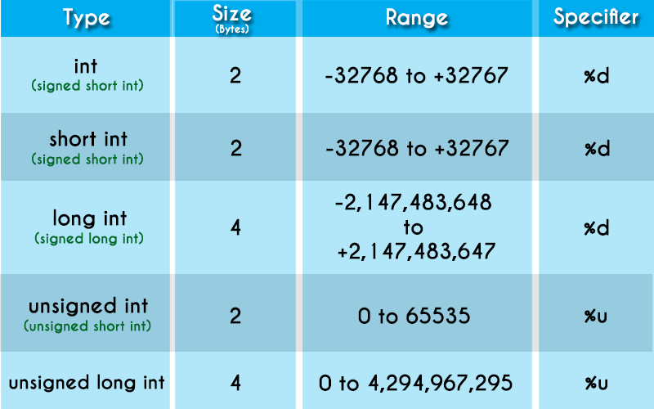
Datatypes- Integer Datatype
The keyword "int" is used to represent integer datatype in c.
The integer datatype is used with different type modifiers like short, long, signed and unsigned.
The following table provides complete details about integer datatype.

Slide 26
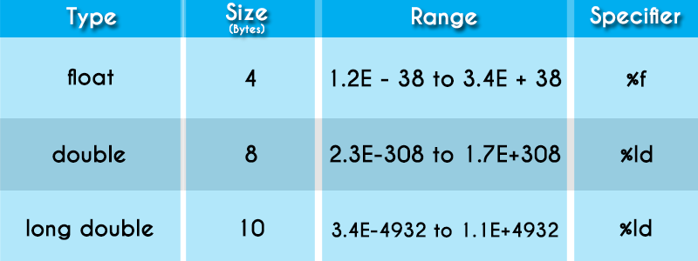
Datatypes- Floating Point Datatypes
Floating point datatypes are set of numbers with decimal value.
The floating point datatype has two variants...
  float
  double
Both float and double are similar but differ in number of decimal places.
  float value contains 6 decimal places.
  double value contains 15 or 19 decimal places.
The following table provides complete details about floating point datatypes.

Slide 27
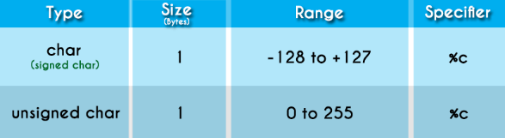
Datatypes- Character Datatype
Character datatype is a set of characters enclosed in single quotations.
The following table provides complete details about character datatype.

Slide 28
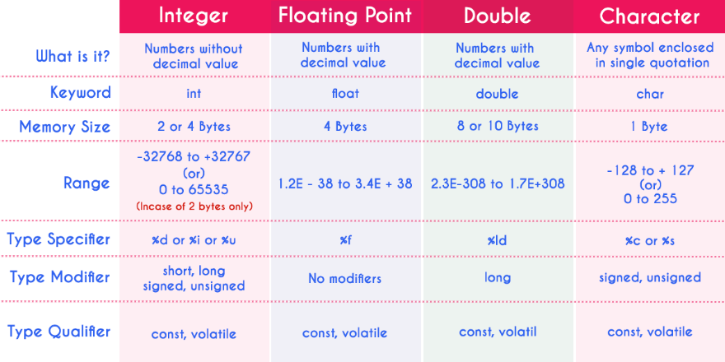
Datatypes
The following table provides complete information about all the datatypes in c programming language.

Slide 29
Datatypes- void Datatype
The void datatype means nothing or no value.
Generally, void is used to specify a function which does not return any value.
We also use the void datatype to specify empty parameters of a function.

Slide 30
User-defined Data Types- typedef in C
typedef is a keyword used in C language to assign alternative names to existing datatypes.
syntax for using typedef
    typedef <existing_name> <alias_name>
    C program to demonstrate typedef
    #include <stdio.h>
    // After this line BYTE can be used in place of unsigned char
    typedef unsigned char BYTE;
    int main()
    {
    BYTE b1, b2;
    b1 = 'c';
    printf("%c ", b1);
    return 0;
    }

Slide 31
User-defined Data Types- Enumerated Datatype
An enumerated datatype is a user-defined data type that consists of integer constants and each integer constant is given a name.
The keyword "enum" is used to define enumerated datatype.
It is defined as follows:
  enum identifier{value1, value2,…..valuen};
  They can be defined in two ways:
  // In both of the below cases, "day" is defined as the variable of type week.
  enum week{Mon, Tue, Wed};
  enum week day;
  // Or
  enum week{Mon, Tue, Wed}day;

Slide 32
Example- Enumerated Datatype
  // An example program to demonstrate working of enum in C
  #include<stdio.h>
  enum week{Mon, Tue, Wed, Thur, Fri, Sat, Sun};
  int main()
  {
  enum week day;
  day = Wed;
  printf("%d",day);
  return 0;
  }
By default, Mon is 0, Tue is 1 and so on.
You can change default values of enum elements during declaration (if necessary).

Slide 33
Declaration of Storage Class
Storage class in C decides the part of storage to allocate memory for a variable, it also determines the scope of a variable.
All variables defined in a C program get some physical location in memory where variable's value is stored.
Memory and CPU registers are types of memory locations where a variable's value can be stored.
The storage class of a variable in C determines the life time of the variable if this is 'global' or 'local'.
Along with the life time of a variable, storage class also determines variable's storage location (memory or registers), the scope (visibility level) of the variable, and the initial value of the variable.

Slide 34
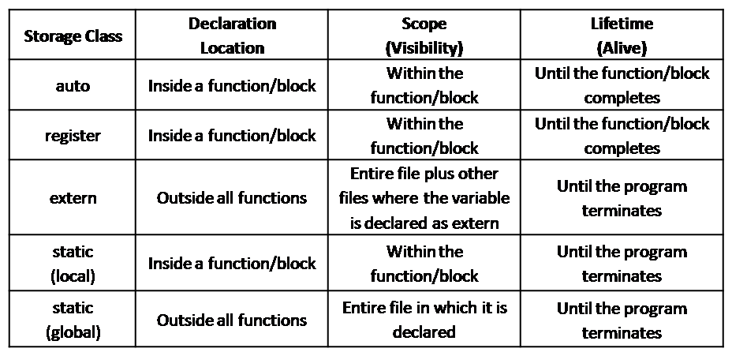
Declaration of Storage Class

Slide 35
Declaration of Storage Class
The general form of a variable declaration that uses a storage class is shown here:
storage_class_specifier data_type variable_name;
At most one storage class specifier may be given in a declaration.
If no storage class specifier is specified then following rules are used:
  Variables declared inside a function are taken to be auto.
  Functions declared within a function are taken to be extern.
  Variables and functions declared outside a function are taken to be static, with external linkage.

Slide 36
Assigning values to variables
The general form of a variable declaration that uses a storage class is shown here:
The syntax is
Variable_name=constant
Example:
      int a=20;
      bal=75.84;
      yes=’x’;
C permits multiple assignments in one line.
Example:
initial_value=0;final_value=100;

Slide 37
Reading data from keyword
Another way of giving values to variables is to input data through keyboard using the scanf function.
The general format of scanf is as follows.
scanf(“control string”,&variable1,&variable2,….);
The ampersand symbol & before each variable name is an operator that specifies the variable name’s address.
Example:
scanf(“%d”,&number);

Slide 38
#define Directive
The #define directive allows the definition of macros within your source code.
These macro definitions allow constant values to be declared for use throughout your code.
The syntax for creating a constant using #define in the C language is:
      #define CNAME value
      OR
      #define CNAME (expression)
value:
The value of the constant.
CNAME:
The name of the constant. Most C programmers define their constant names in uppercase, but it is not a requirement of the C Language.
expression:
Expression whose value is assigned to the constant.
The expression must be enclosed in parentheses if it contains operators.

Slide 39
#define Directive - Example
  #include <stdio.h>
  #define NAME "Charusat"
  #define YEAR 2000
  int main()
  {
  printf("%s is established in year %d\n", NAME, YEAR);
  return 0;
  }

Slide 40
Difference between #define & const
The big advantage of const over #define is type checking.
We can typecast them and any other thing that can be done with a normal variable.
One disadvantage that one could think of is extra space for variable which is immaterial due to optimizations done by compilers.
In general const is a better option if we have a choice. There are situations when #define cannot be replaced by const. For example, #define can take parameters. #define can also be used to replace some text in a program with another text.

Slide 41
Declaring a variable as volatile
ANSI standard defines another qualifier, volatile that could be used to tell explicitly the compiler that a variable's value may be changed at any time by some external sources.
By declaring a variable as volatile, its value may be changed at any time by some external source.
Example:
volatile int date;
The date may be altered by some external factors even if it does not appear on the left hand side of assignment statement.

Slide 42
Overflow and Underflow of Data
Based on the storage size of data types in any particular system there is a fixed range of values that can be stored in a variable of a given data types.
Overflow: The assignment of a value larger than the storage capacity of the data type of a variable can hold.
Underflow: The assignment of a value smaller than the storage capacity of the data type of a variable can hold.
C does not provide any warning or indication of Overflow and underflow, It simply gives incorrect results.
So, It is recommended to define correct data type for handling the input/output values.

Slide 43
Datatypes- Derived Datatypes
Derived datatypes are user-defined data types.
The derived datatypes are also called as user defined datatypes or secondary datatypes.
In c programming language, the derived datatypes are created using the following concepts...
  Arrays
  Structures
  Unions
  Enumeration

Slide 44
Previous Year Questions
Classify following variables into valid & invalid variable name in C.
  %, (area), mark, 25th, 123, distance
What are the advantages of user defined function?
Classify between valid and Invalid variable names?
RAM, ANSI, GJ@India, Float variable, One_int, ID#22
Give difference between variables and constants.

Slide 45
Previous Year Questions
Why and When do we use the #define directive? OR Explain #define?
What are trigraph characters? How are they useful?
Explain C Tokens with example?
Explain three types of datatypes with example?
Is main() a user defined function? if yes how does it differ from other user-defined function? if No, give reason for it.

Slide 46


